Slide 1

Pre-AP: Empowering
Every Student to Learn, Grow,
and Succeed
Exploring Pre-AP with Teachers
Notes:
Share purpose / goals for presentation to teachers

Slide 2

What is Pre-AP?
I

Slide 3
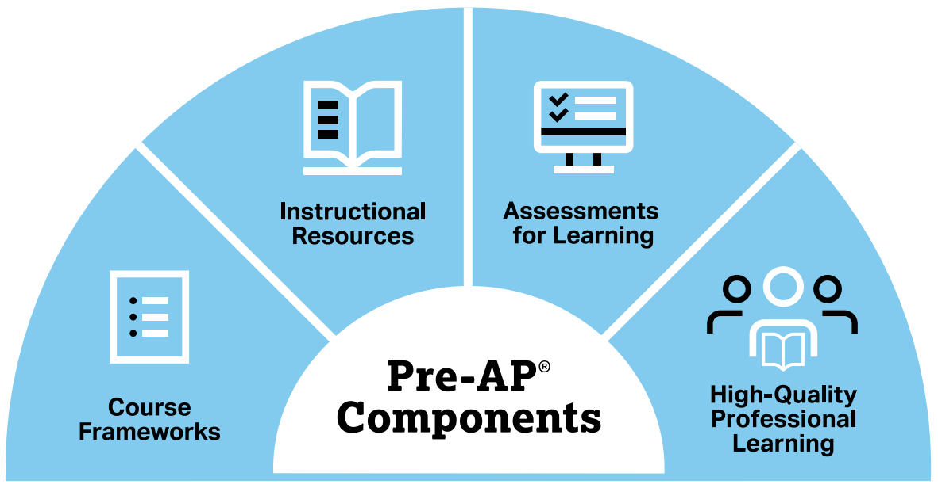
Pre-AP Course Components
The Pre-AP Program is designed to give all students the opportunity to learn the foundational knowledge and critical thinking skills they need to achieve their full potential.
The Pre-AP Components provide students the four key resources recommended by TNTP:
Grade-appropriate assignments
Strong instruction
Deep engagement
High expectations
Notes:
Course frameworks
Provide clear and focused description of what students should know and be able to do as a result of the course.
Increases clarity and provides transparency to both teachers and students about the most essential knowledge and skills students will need for active, confident participation in subsequent high school courses, including Advanced Placement courses, as well as college coursework and postsecondary careers.
Deeply informed by state standards documents.
Instructional Resources
Model lessons that feature motivating classroom activities, engaging texts and challenging practice.
Intended to model for teachers how to develop engaging instruction that addresses the content and skills of the course framework as well as bring the shared principles to life.
Provided digitally (in print for cost)
Learning Checkpoints
Formative checks for understanding
8 learning checkpoints per course, 2 per Unit
Digitally-delivered
Multiple-choice
Completed with one class period
Student- and teacher-facing reporting
Collaborative Educator Workshops: https://pre-ap.collegeboard.org/professional-learning
Online Foundational Module Series
Online Performance Task Scoring Modules
Online Leadership Workshop

Slide 4




Pre-AP Approach to Teaching and Learning
Horizontally and Vertically Aligned Instruction
Shared Principles, Areas of Focus
The three approaches are as follows:
Focused Content
Course Frameworks, Model Lessons
High-Quality Professional Learning
Educators Bring it All Together
Targeted Assessments and Feedback
Learning Checkpoints, Performance Tasks, Final Exam
Notes:
Pre-AP courses invite all students to learn, grow, and succeed through focused content, horizontally and vertically aligned instruction, and targeted assessments for learning. Pre-AP Professional Learning prepares teachers and leaders to use Pre-AP in their schools.

Slide 5
Flexibility to Meet Your Students’ Needs
Pre-AP course frameworks are aligned to College and Career Readiness and AP standards.
Pre-AP courses are designed to support student success in PSAT-related assessments, SAT, AP, and other college readiness indicators.
Pre-AP doesn’t cover 100% of instructional time.
Pre-AP courses will address most of your state standards, and we provide standards crosswalks.
Our program is intentionally flexible and can sit alongside your existing curriculum and allow you to use your local content to address specific state standards not covered in Pre-AP.

Slide 6

Why Pre-AP?
II
Notes:
This segment explores why the College Board believes Pre-AP is the best way to bring equity and access to all students.
Throughout this segment, help participants draw connections to your own site / district vision for all students.

Slide 7


Benefits of Pre-AP
Students
Teachers
Schools
Access and Opportunity
Critical Thinking Skills
Increased Engagement and Growth through Motivating Resources
Engaging Model Lessons
Course Frameworks provide Focus
Learning Checkpoints
Cross-Curricular Alignment: 12 courses in 5 content areas
Teacher Collaboration
Professional Growth

Slide 8

Student Impact
Notes:
Please play the following video on YouTube: https://youtu.be/u5mkCKOhKlY

Slide 9
Pre-AP for All
Pre-AP frameworks and assessments serve as the foundation for all sections of the course at the school.
Pre-AP Equity and Access Policy: College Board believes that all students deserve engaging and challenging grade-level coursework. Increasing access to this type of coursework leads to increased opportunities for all students, including groups that have been traditionally underrepresented in AP and college classrooms. Therefore, the Pre-AP program is dedicated to collaborating with educators across the country to ensure all students have access to meaningful classroom experiences that allow them to learn, grow, and build their confidence. It is only through a sustained commitment to equitable preparation and access that true excellence can be achieved for all students, and the Pre-AP course designation requires this commitment.
Notes:
Pre-AP for all means that PreAP frameworks and assessments ARE the foundation for ALL sections of the particular course.
The Pre-AP Equity and Access Policy highlights that all students deserve this opportunity.
The Pre-AP®Program recognizes the autonomy of secondary schools and districts in setting course participation policies that best meet their students’ unique needs and learning goals. At the same time, Pre-AP courses are specifically designed to provide grade-level course work based on high school content, skills, and expectations.

Slide 10
I've noticed that the students have started to adopt more of a growth mindset. We've been focusing on learning that struggling is okay and making mistakes is okay. We're taking a lot of time to do things, but they're gaining skills along the way.
Quote from our focus groups of teachers during the 2019-2020 school year
Notes:
This is a quote from our focus groups of teachers during the 2019-2020 school year.

Slide 11

Pre-AP Program Commitments
III
Notes:
This segment explores the four Pre-AP program commitments necessary for Pre-AP course designation.
Throughout this segment, assess what resources and supports teachers need in order to fulfill these commitments.

Slide 12
Pre-AP Program Commitments
Pre-AP for All: Pre-AP frameworks and assessments serve as the foundation for all sections of the course at the school.
Course Frameworks: Teachers align classroom instruction to the course frameworks.
Assessments: Teachers administer at least 1 learning checkpoint per unit, and 4 performance tasks.
Professional Learning: Teachers and the Pre-AP Coordinator complete professional learning offered by the College Board
Notes:
Schools participating in the College Board Pre-AP Program must go through the Pre-AP Course Audit. The Pre-AP Course Audit ensures that all teachers and course audit administrators agree to complete specific activities to receive an official Pre-AP course designation. This is a commitment they make to their students, fellow teachers, and school leadership.
The Pre-AP Course Audit is intended to:
Give Pre-AP teachers and coordinators clear guidelines on curricular, resource, and implementation commitments that each Pre-AP course agrees to in order to receive a Pre-AP course designation.
Give colleges and universities confidence that Pre-AP courses are designed to meet the same criteria across all schools.
Note: You may pull additional slides for each Pre-AP program commitment from the Source Deck
Optional language: School leadership may defer the Pre-AP For All commitment under the following conditions:
School refrains from establishing any entry barriers (e.g., minimum test scores, previous grades, or teacher recommendation) which could hinder students’ participation in the Pre-AP course
School develops a plan to increase enrollment of students in Pre-AP courses over time
The Pre-AP program will monitor course enrollment for schools who defer this commitment.

Slide 13


Course Frameworks
Pre-AP course frameworks are focused and aligned to College and Career Readiness and AP standards.
Pre-AP courses are designed to support student success in PSAT-related assessments, SAT, AP, and other college readiness indicators.
Pre-AP course frameworks focus on the most critical content and skills to allow for deep engagement.
Our program is intentionally flexible and can sit alongside your existing curriculum and allow you to use your local content to address specific state standards not covered in Pre-AP.
Pre-AP courses demonstrates strong alignment to your state standards, as articulated in our standards crosswalks
Available NOW at preap.org
Notes:
Pre-AP courses focus deeply on a limited number of concepts and skills with the broadest relevance for high school coursework and college and career success. The course framework serves as the foundation of the course and defines these prioritized concepts and skills. The course design provides students and teachers with intentional permission to slow down and focus.
Note: if you are presenting to a state that doesn’t have a standards crosswalk, remove the last bullet

Slide 14

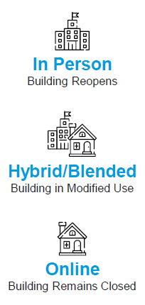
Instructional Resources
Pre-AP model lessons and performance tasks are based directly on the focused framework.
Pre-AP resources support distance, hybrid, and modified in-person
learning environments.
Teacher print and digital resources
Model Lessons provided for ~50% of the course framework content
Interactive student handouts
Audio files of texts
Partnerships with Desmos, Quill, Vocabulary.com, and Wordplay
Editable Companion Slides for most Model Lessons support distance/hybrid learning environments

Slide 15

Assessments
for Learning
Pre-AP courses include strategically designed classroom assessments that serve as tools for understanding progress and identifying areas that need more support.
Pre-AP assessments provide frequent and meaningful feedback for both teachers and students across each unit of the course and for the course
as a whole.
8 digital assessments per course
4 student performance tasks per course
1 digital final exam per course
Assessment reporting
Notes:
Assessment FOR learning vs. assessment of the learning.
Pre-AP Assessments are intended to inform instruction, allowing teachers and students to reflect and make change going forward
Note: arts courses do not have learning checkpoints or final exams.

Slide 16
Professional Learning
Pre-AP Summer Institutes - Teachers
Course-specific 4-day collaborative workshops
Support teachers in planning and preparing for their Pre-AP course
Develop connections within the Pre-AP Community
Online Foundational Module Series - Teachers
8 course-specific eLearning modules taking 12–20 hours to complete
Support teachers in planning and preparing for their Pre-AP course
Optional synchronous virtual training led by Pre-AP National Faculty instructors to extend the learning
Pre-AP Leadership Workshop & Online Leadership Modules
1-day workshop for Pre-AP Coordinators and school/district administrators
4 course-specific eLearning modules taking 4-6 hours to complete
Pre-AP Coordinator Module
Designated Pre-AP Coordinator commits to completing Module
Approx. 1 hour to complete
Notes:
Collaborative Educator Workshops.
Without the guidance and support of the educator, Pre-AP course goals would not be achieved. Educators can choose between either the summer institute or the foundational module series to meet the commitment – they do not need to participate in both.

Slide 17
Shared Principles and Areas of Focus
IV

Slide 18
Pre-AP Shared Principles
Students build critical thinking skills to approach new and challenging content.
Close Observation
and Analysis
Higher-Order Questioning
Evidence-Based
Writing
SHARED
PRINCIPLES
Academic
Conversation

Slide 19

Close Observation And Analysis
Students are provided time to carefully observe one data set, text, image, performance piece, or problem before being asked to explain, analyze, or evaluate.
This creates a safe entry point to simply express what they notice and what they wonder. It also encourages
students to slow down and capture relevant details with intentionality to support more meaningful analysis, rather than rushing to completion at the expense of understanding.

Slide 20

Evidence-Based Writing
With strategic support, students frequently engage in writing coherent arguments from relevant and valid sources of evidence.
Pre-AP courses embrace a purposeful and scaffolded approach to writing that begins with a focus on precise and effective sentences before progressing to longer forms of writing.

Slide 21

Higher-Order Questioning
Students engage with questions designed to encourage thinking that is elevated beyond simple memorization and recall. Higher-order questions require students to make predictions, synthesize, evaluate, and compare.
As students grapple with these questions, they learn that being inquisitive promotes extended thinking and leads to deeper understanding.

Slide 22

Academic Conversation
Through peer-to-peer dialogue, students’ ideas are explored, challenged, and refined. As students engage in academic conversation, they come to see the value in being open to new ideas and modifying their own ideas based on new information.
Students grow as they frequently practice this type of respectful dialogue and critique and learn to recognize that all voices, including their own, deserve to be heard.

Slide 23
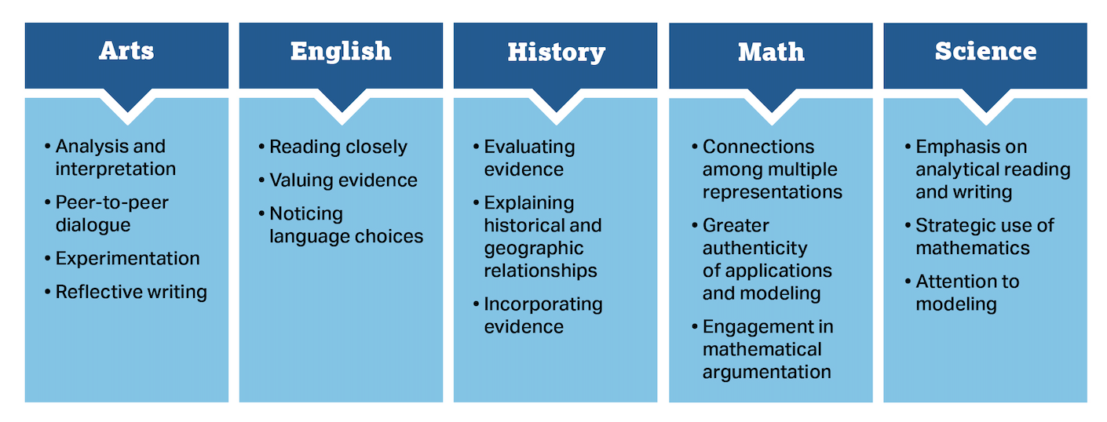
Areas of Focus
Shared Principles
Close Observation and Analysis | Evidence-based Writing | Higher-Order Questioning | Academic Conversation
Notes:
Each course is also aligned to discipline-specific areas of focus that prioritize the critical reasoning skills and practices central to that discipline.
The areas of focus are discipline-specific reasoning skills that students develop and leverage as they engage with content.
Whereas the shared principles promote horizontal alignment across disciplines, the areas of focus provide vertical alignment within a discipline, giving students the opportunity to strengthen and deepen their work with these skills in subsequent courses in the same discipline.

Slide 24
Pre-AP Courses
III
Notes:
Section III: Pre-AP Courses
Provides an overview of the Pre-AP Courses available
Consider deleting slides for courses you are not offering

Slide 25


Pre-AP Courses
These High School Level Courses may be used at the grade-level that is appropriate based on local requirements and practices, including middle school.
English
Mathematics
Pre-AP English 1
Pre-AP English 2
Pre-AP Algebra 1
Pre-AP Geometry with Statistics
Pre-AP Algebra 2
Social Studies
Science
Pre-AP World History and Geography
Pre-AP Biology
Pre-AP Chemistry
Arts
Pre-AP Dance
Pre-AP Music
Pre-AP Theatre
Pre-AP Visual Arts

Slide 26







Pre-AP Humanities Courses

Slide 27
Pre-AP English 1
Pre-AP English 2
Why Pre-AP English?
Texts take time.
Students are asked to observe, to notice, and to enjoy what they read—
which inspires confidence and persistence.
Writing takes practice.
Students write daily, and they are guided to produce strong sentences
before progressing to paragraphs and essays.
Words matter.
Students move beyond memorizing definitions as they investigate why writers and speakers choose one word or phrase instead of another.

Slide 28
Pre-AP English 1
Instructional Units
Unit 1: Telling Details
Unit 2: Pivotal Words and Phrases
Unit 3: Compelling Evidence
Unit 4: Powerful Openings
Areas of Focus
Reading Closely
Valuing Evidence
Noticing Language Choices
Notes:
Course Framework
Pre-AP courses focus deeply on a limited number of concepts and skills with the broadest relevance for high school coursework and college and career success.
The course framework serves as the foundation of the course and defines these prioritized concepts and skills.
The course design provides students and teachers with intentional permission to slow down and focus.
Instructional Units
Instructional units and assessments are based directly on this focused framework.
Teacher resources, available in print and online, include a robust set of model lessons for each Instructional Unit that demonstrate how to translate the course framework, shared principles, and areas of focus into daily instruction. Use of the model lessons is encouraged but not required.
Areas of Focus
The areas of focus are discipline-specific reasoning skills that students develop and leverage as they engage with content.
The areas of focus provide vertical alignment within a discipline, giving students the opportunity to strengthen and deepen their work with these skills in subsequent courses in the same discipline.
Note the areas of focus remain consistent across all courses within a discipline.

Slide 29
Pre-AP English 2
Instructional Units
Unit 1: Moves in Argument
Unit 2: Persuasion in Literature
Unit 3: Voice in Synthesis
Unit 4: Purpose in Poetry and Prose
Areas of Focus
Reading Closely
Valuing Evidence
Noticing Language Choices
Notes:
Course Framework
Pre-AP courses focus deeply on a limited number of concepts and skills with the broadest relevance for high school coursework and college and career success.
The course framework serves as the foundation of the course and defines these prioritized concepts and skills.
The course design provides students and teachers with intentional permission to slow down and focus.
Instructional Units
Instructional units and assessments are based directly on this focused framework.
Teacher resources, available in print and online, include a robust set of model lessons for each Instructional Unit that demonstrate how to translate the course framework, shared principles, and areas of focus into daily instruction. Use of the model lessons is encouraged but not required.
Areas of Focus
The areas of focus are discipline-specific reasoning skills that students develop and leverage as they engage with content.
The areas of focus provide vertical alignment within a discipline, giving students the opportunity to strengthen and deepen their work with these skills in subsequent courses in the same discipline.
Note the areas of focus remain consistent across all courses within a discipline.

Slide 30

“I would say my kids' confidence has grown a lot. At the beginning of the year, we would read a story, and they would look at me like, 'I don't know this.' But, right now, if you were to walk into my classroom today, we read a story together, and they had to find contrast in the story, then they had to find evidence for it.”
—Pre-AP English 1 Teacher from Boca Raton Community School - FL
“I don't have to pull or prod the students along because they already know the answer. This gives us an opportunity for deeper and richer analysis, which is obviously our goal.”
—Pre-AP English 1 Teacher from Coronado High School - TX

Slide 31
Pre-AP World History and Geography
Why Pre-AP World History
and Geography?
Being inquisitive investigators.
Students encounter a range of primary and secondary sources as
they regularly practice discovering, investigating, and weighing evidence.
Making connections across time and space.
Students learn much more than discrete facts as they master the disciplinary skills of contextualization, causation, comparison, and continuity and change over time.
Weighing evidence and crafting original arguments.
Students internalize that claims require accurate, appropriate evidence, and they hone their ability to write arguments through practice and culminating writing tasks.

Slide 32
Pre-AP World History and Geography
Areas of Focus
Instructional Units
Pathway 1:
Geography and World Regions
The Ancient Period
The Classical Period
The Post Classical Period
Pathway 2:
Geography and World Regions
The Early Modern Period
The Modern Period
The Contemporary Period
Evaluating Evidence
Incorporating Evidence
Historical
and Geographic Relationships
Notes:
Course Framework
Pre-AP courses focus deeply on a limited number of concepts and skills with the broadest relevance for high school coursework and college and career success.
The course framework serves as the foundation of the course and defines these prioritized concepts and skills.
The course design provides students and teachers with intentional permission to slow down and focus.
Instructional Units
Instructional units and assessments are based directly on this focused framework.
Teacher resources, available in print and online, include a robust set of model lessons for each Instructional Unit that demonstrate how to translate the course framework, shared principles, and areas of focus into daily instruction. Use of the model lessons is encouraged but not required.
Areas of Focus
The areas of focus are discipline-specific reasoning skills that students develop and leverage as they engage with content.
The areas of focus provide vertical alignment within a discipline, giving students the opportunity to strengthen and deepen their work with these skills in subsequent courses in the same discipline.
Note the areas of focus remain consistent across all courses within a discipline.

Slide 33
Pre-AP World History and Geography
The course is organized by seven units: one geography unit to open the year and six units based on historical periods. Schools may choose one of two pathways: Geography and Historical Periods 1-3, or Geography and Historical Periods 4-6 to best align to their district course sequence and state standards.
Instructional Units:

Slide 34
Pre-AP Arts
Why Pre-AP Arts?
The process is important—not just the product or performance.
Pre-AP Arts courses include a deliberate focus on the process of producing creative works, including generating and refining ideas, practicing skills and techniques, revision, reflection, and collaboration.
Assessments must be authentic and relevant.
Pre-AP Arts assessments address the purposeful refinement and revision of creative work and the ability to reflect on and communicate about that work in addition to technical skill development.
Flexibility and accessibility are vital for high school arts programs.
Pre-AP Arts instructional lessons include recommendations for adapting the instruction to a variety of settings, making use of whatever resources are available to enhance existing performance-focused courses.

Slide 35
Pre-AP Arts
Four distinct courses:
Dance
Music
Theatre
Visual Arts
Areas of Focus
Peer-to-Peer Dialogue
Analysis and Interpretation
Reflective Writing
Experimentation
Notes:
Course Framework
Pre-AP courses focus deeply on a limited number of concepts and skills with the broadest relevance for high school coursework and college and career success.
The course framework serves as the foundation of the course and defines these prioritized concepts and skills.
The course design provides students and teachers with intentional permission to slow down and focus.
Instructional Modules
Modules and performance assessments are based directly on this focused framework.
Teacher resources, available in print and online, include a robust set of model lessons for each Module that demonstrate how to translate the course framework, shared principles, and areas of focus into daily instruction. Use of the model lessons is encouraged but not required.
Areas of Focus
The areas of focus are discipline-specific reasoning skills that students develop and leverage as they engage with content.
The areas of focus provide vertical alignment within a discipline, giving students the opportunity to strengthen and deepen their work with these skills in subsequent courses in the same discipline.
Note the areas of focus remain consistent across all courses within a discipline.

Slide 36

“No matter what assignment they were given or what prompt, they were able to take it. Even the ones that have absolutely no dance experience, they were able to incorporate dance movement that we had taught prior into whatever context it was.”
Pre-AP Arts Teacher from Boca Raton Community High School - FL

Slide 37



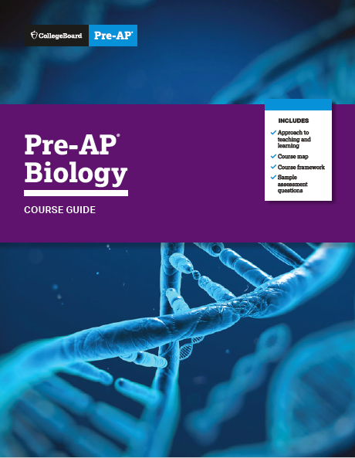
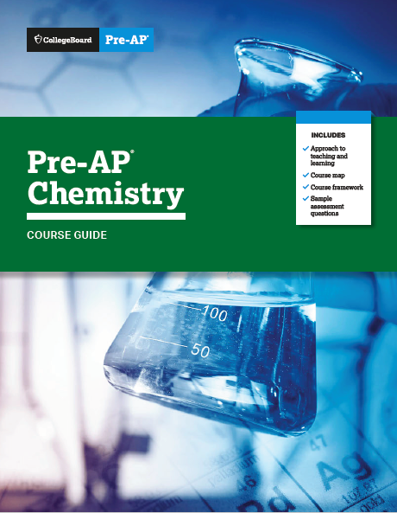
Pre-AP STEM Courses

Slide 38

Pre-AP Algebra 1
Why Pre-AP Algebra 1?
More intentional time and focus to gain mastery of linear relationships.
A deep understanding of linear relationships provides a strong foundation for success in subsequent mathematics and fuels readiness for many social and natural sciences.
Compelling and authentic problems and contexts engage students in opportunities to think like mathematicians.
Students will experience real applications from a variety of sources for which linear, quadratic, or exponential functions are natural choices to quantify, explain, and investigate the phenomena.

Slide 39
Pre-AP Algebra 1
Course Units:
Unit 1: Linear Functions
and Linear Equations
Unit 2: Systems of Linear
Equations and Inequalities
Unit 3: Quadratic Equations
and Functions
Unit 4: Exponents and
Exponential Functions
Areas of Focus
Mastery
of Linear
Equations
and Linear
Functions
Authentic Applications
and Modeling
Engagement in Mathematical Argumentation
Notes:
Course Framework
Pre-AP courses focus deeply on a limited number of concepts and skills with the broadest relevance for high school coursework and college and career success.
The course framework serves as the foundation of the course and defines these prioritized concepts and skills.
The course design provides students and teachers with intentional permission to slow down and focus.
Instructional Units
Instructional units and assessments are based directly on this focused framework.
Teacher resources, available in print and online, include a robust set of model lessons for each Instructional Unit that demonstrate how to translate the course framework, shared principles, and areas of focus into daily instruction. Use of the model lessons is encouraged but not required.
Areas of Focus
The areas of focus are discipline-specific reasoning skills that students develop and leverage as they engage with content.
The areas of focus provide vertical alignment within a discipline, giving students the opportunity to strengthen and deepen their work with these skills in subsequent courses in the same discipline.
Note the areas of focus remain consistent across all courses within a discipline.

Slide 40
Pre-AP Geometry with Statistics
Why Pre-AP Geometry with Statistics?
Examine many problems that can be solved using both algebraic and geometric approaches.
Students often struggle to see the connections between algebra and geometry because they are rarely made explicit. Therefore, this course will provide students with a meaningful and explicit conceptual bridge between algebraic and geometric problem-solving methods that deepens their understanding of mathematics.
Provide a consolidated, deeper exploration of concepts in probability and statistics to develop quantitative literacy.
Statistics and probability topics are typically distributed across middle school and the three traditional high school courses, and there are often few differences in the language, and thereby classroom expectations, between the middle school and high school probability and statistics standards.

Slide 41
Pre-AP Geometry with Statistics
Course Units:
Unit 1: Statistics & Probability
Unit 2: Tools and Techniques of
Measurement
Unit 3: Measurement of Similar
and Congruent Figures
Unit 4: Measurement in Two and
Three Dimensions
Areas of Focus
Connections Among Multiple Representations
Authentic Applications
and Modeling
Engagement in Mathematical Argumentation
Notes:
Course Framework
Pre-AP courses focus deeply on a limited number of concepts and skills with the broadest relevance for high school coursework and college and career success.
The course framework serves as the foundation of the course and defines these prioritized concepts and skills.
The course design provides students and teachers with intentional permission to slow down and focus.
Instructional Units
Instructional units and assessments are based directly on this focused framework.
Teacher resources, available in print and online, include a robust set of model lessons for each Instructional Unit that demonstrate how to translate the course framework, shared principles, and areas of focus into daily instruction. Use of the model lessons is encouraged but not required.
Areas of Focus
The areas of focus are discipline-specific reasoning skills that students develop and leverage as they engage with content.
The areas of focus provide vertical alignment within a discipline, giving students the opportunity to strengthen and deepen their work with these skills in subsequent courses in the same discipline.
Note the areas of focus remain consistent across all courses within a discipline.

Slide 42
“I've been surprised by their ability to grapple with challenging mathematical problem solving. And if they're not successful the first time or the second time or the third time, by the fourth or fifth time they're like, "Oh, I can do that. No problem." So they've really bought into the idea that it's okay to face challenging material and not necessarily have it come easy to them.”
—Pre-AP Algebra 1 Teacher from Bronx Collaborative School - NY
“At the student level, they see the growth that they're doing. And it gives them hope. A lot of these kids that haven't been in Pre-AP in the past, or Pre-AP lite, and have just gone through education as that regular student, they're seeing their potential to really soar.”
—Pre-AP Algebra 1 Teacher from Bryan High School - TX
“…this semester we're doing a lot more like hands on, moving around and my grades improved a lot. That's why I wanna be an engineer now because I like math now.”
—Pre-AP Algebra 1 Student from CE King School - TX

Slide 43
Pre-AP Biology
Why Pre-AP Biology?
Purposeful connection of concepts.
Students must routinely use, build upon, and connect their prior knowledge to new concepts, and new concepts are strategically scaffolded throughout the course to allow for these meaningful connections to emerge.
Contexts must provide meaningful opportunities for curiosity,
observation, and analysis.
Students will routinely engage in the work of scientists as they observe
and analyze living systems that are grounded in real-world data and
natural phenomena.

Slide 44
Pre-AP Biology
Course Units:
Unit 1: Ecological Systems
Unit 2: Evolution
Unit 3: Cellular Systems
Unit 4: Genetics
Areas of Focus
Analytical
Reading and Writing
Applying Mathematics
Attention to Modeling
Notes:
Course Framework
Pre-AP courses focus deeply on a limited number of concepts and skills with the broadest relevance for high school coursework and college and career success.
The course framework serves as the foundation of the course and defines these prioritized concepts and skills.
The course design provides students and teachers with intentional permission to slow down and focus.
Instructional Units
Instructional units and assessments are based directly on this focused framework.
Teacher resources, available in print and online, include a robust set of model lessons for each Instructional Unit that demonstrate how to translate the course framework, shared principles, and areas of focus into daily instruction. Use of the model lessons is encouraged but not required.
Areas of Focus
The areas of focus are discipline-specific reasoning skills that students develop and leverage as they engage with content.
The areas of focus provide vertical alignment within a discipline, giving students the opportunity to strengthen and deepen their work with these skills in subsequent courses in the same discipline.
Note the areas of focus remain consistent across all courses within a discipline.

Slide 45

Pre-AP Chemistry
Why Pre-AP Chemistry?
Develop a deep, coherent conceptual understanding of matter at the molecular level by moving strategically from macroscopic to atomic explorations.
A deep understanding of the properties of matter provides a strong foundation for success in subsequent science courses, including AP. Therefore, we start the course with macroscopic properties of everyday materials that are relevant and easily observable and progress throughout the course to the study of increasingly deeper and more detailed and abstract perspectives.
Use context-driven mathematics to establish connections between quantitative and conceptual understandings.
Mathematical calculations are necessary to explore important concepts in chemistry. However, without context-focused applications for these calculations, students can find themselves able to solve problems but lacking understanding of the underlying chemical principles.

Slide 46
Pre-AP Chemistry
Course Units:
Unit 1: Particle View of Matter
Unit 2: Particle Interactions
Unit 3: Chemical Quantities
Unit 4: Chemical Transformations
Areas of Focus
Analytical
Reading and Writing
Applying Mathematics
Attention to Modeling
Notes:
Course Framework
Pre-AP courses focus deeply on a limited number of concepts and skills with the broadest relevance for high school coursework and college and career success.
The course framework serves as the foundation of the course and defines these prioritized concepts and skills.
The course design provides students and teachers with intentional permission to slow down and focus.
Instructional Units
Instructional units and assessments are based directly on this focused framework.
Teacher resources, available in print and online, include a robust set of model lessons for each Instructional Unit that demonstrate how to translate the course framework, shared principles, and areas of focus into daily instruction. Use of the model lessons is encouraged but not required.
Areas of Focus
The areas of focus are discipline-specific reasoning skills that students develop and leverage as they engage with content.
The areas of focus provide vertical alignment within a discipline, giving students the opportunity to strengthen and deepen their work with these skills in subsequent courses in the same discipline.
Note the areas of focus remain consistent across all courses within a discipline.

Slide 47
“For biology, it's really challenging because…you have to really think about what you write, and you have to really annotate to get the gist of what you write to make it all make sense for you to understand. Then when I do that, it really becomes really easy. Every time I get a test, I know what I'm looking for.”
—Pre-AP Biology Student from Boca Raton Community School - FL
“It's finally nice to actually enjoy science, like I look forward to my science class. In middle school I did not, I was like ‘why do I have to go to science’? In the past I only liked science because my friends were in it, and now I actually like it because I like it.”
—Pre-AP Biology Student from Marine Creek High School – TX
“I think that their evidence-based writing has surpassed my expectations this second semester, because I have a lot of writing samples now, and they're using academic vocabulary.”
—Pre-AP Biology Teacher from Bryan High School - TX

Slide 48
Unique School Contexts
V

Slide 49








SpringBoard and Pre-AP
SpringBoard Program | Pre-AP Program
Full Curriculum | Set of courses
ELA and Math Only | All content areas
District-or school-adopted curriculum, which includes comprehensive instructional materials | Course frameworks with model lessons that provide blueprints for instruction, giving teachers the flexibility to use the instructional resources of their choice
No official designation | Official course designation with inclusion in the Pre-AP Ledger
Notes:
SpringBoard® provides a full curriculum solution for Pre-AP schools in Math and English Language Arts.
Pre-AP schools that also use SpringBoard receive curriculum pathway documents that indicate which SpringBoard activities and assessments to use with Pre-AP courses in order to fully address the course frameworks.
The Curriculum Pathway documents reflect one approach to using SpringBoard materials along with all of the Pre-AP model lessons to meet the expectations of the Pre-AP course framework. We encourage teachers to adapt this approach to support their students’ differentiation or assessment needs, or to to meet state-specific requirements. The resources available in SpringBoard provide teachers the flexibility to meet all their students’ needs, while attending to the Pre-AP course framework and assessment commitments.​
Beginning with the SpringBoard National ELA and Texas High School ELA 2021 editions launching in fall 2020, Pre-AP model lessons will be fully integrated into the grade 9 SpringBoard editions, with deep alignment at other grade levels.

Slide 50
Pre-AP at
Middle School
Pre-AP is designed to provide
grade-level coursework based on high school content, skills,
and expectations.
Offer at middle school only if those courses are intended to meet high-school level standards
Additional requirements for account creation for students under 13
Notes:
Remove this slide if not relevant to your audience.
The Pre-AP Program recognizes the autonomy of secondary schools and districts in setting course participation policies that best meet their students’ unique needs and learning goals. At the same time, Pre-AP courses are specifically designed to provide grade-level coursework based on high school content, skills, and expectations.
Pre-AP courses should be offered at the middle school level only if those middle school courses are intended to meet high-school level standards. For example, while Pre-AP Algebra 1 may be appropriate for middle school students who are taking high-school-level Algebra 1, Pre-AP Biology would not be a suitable replacement for an existing Biology course that addresses middle school standards.
When considering offering Pre-AP to younger students, educators should be mindful that College Board believes students are best served by coursework focusing on the academic building blocks necessary for later, successful enrollment in college-level courses. Additionally, Pre-AP is focused on equity and access. All students enrolled in on-level courses should participate in the Pre-AP Program.
Students who are under the age of 13 must have parent permission to create their account. The College Board will provide resources to support this for schools offering the program to younger students.

Slide 51
Pre-AP Next Steps
V

Slide 52
Recommendations for Beginning Pre-AP
1
2
3
4
Build Consensus
Create Your Pre-AP Team
Encourage Teacher Preparation
Family Communication
Share the course guides with instructional leads.
Consider hosting a Pre-AP Readiness Workshop to better understand the foundational elements of Pre-AP.
Discuss program commitments with leadership team.
Determine who will be your Pre-AP coordinator and Pre-AP Course Audit administrator.
Schedule planning time with teachers to review course frameworks within and across grades and subjects.
Review the current curriculum with teachers and let them know they’ll still need it: Pre-AP is not a curriculum.
Ensure counselors understand the program commitments and what will change for students, so they can answer questions from students and parents.

Slide 53


Thank you
preap@collegeboard.org
preap.org
© 2021 College Board

